Slide 1


Build Custom Copilot that Hand-off to Dynamics 365 Customer Service
Vinoth Selvam
Notes:
AI-generated content may be incorrect. In this presentation, we will explore how Copilot Studio can help you build custom copilots for Dynamics 365 Customer Service. We will discuss the key features and benefits of Copilot Studio, go through a step-by-step guide on building custom copilots, and best practices for handoff to Dynamics 365 Customer Service.

Slide 2

Agenda
Overview of Copilot Studio
This section will provide an overview of Copilot Studio, including its features and capabilities.
Building Custom Copilots
In this section, we will explore how to build custom copilots and how to integrate them into your workflows.
Handoff to Dynamics 365 Customer Service
This section will cover how to use Copilot Studio and custom copilots to streamline handoff to Dynamics 365 Customer Service.
Deploy the Copilot in Power Pages Portal
In this section, we will explore how to embed the copilot in a Custom Portal that is developed using Power Pages.
Test the Copilot
Finally. we can test and make sure our Copilot works as expected.
Notes:
In this presentation, we will cover several topics, including an overview of Copilot Studio, building custom copilots, and handoff to Dynamics 365 Customer Service.

Slide 3

Overview
Copilot Studio is a powerful tool for building custom copilots
Notes:
Welcome to our presentation on Building Custom Copilots for Dynamics 365 Customer Service. We are excited to share with you the capabilities of Copilot Studio and how it can help you enhance your customer service.

Slide 4


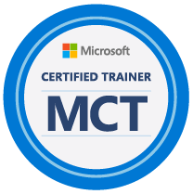


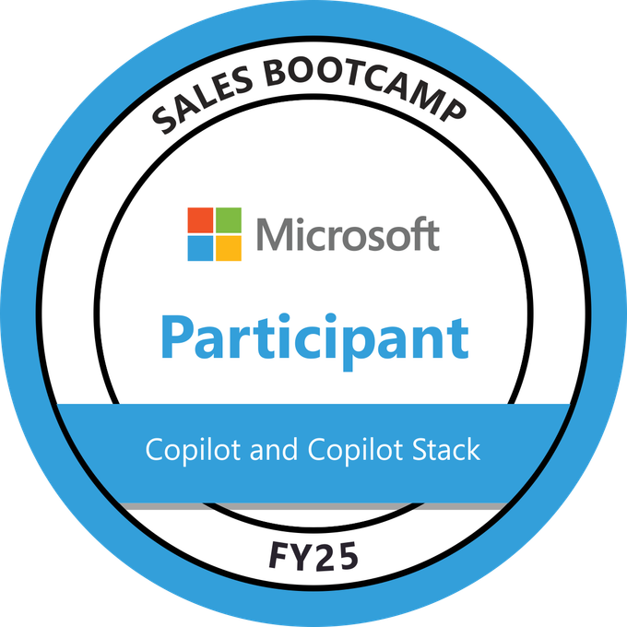
Speaker : Vinoth Selvam
12+ years of total experience in IT Industry with major Experience as Microsoft Dynamics 365 CE/CRM Techno-Functional Consultant handling the Functional & Technical aspects in implementation of various Dynamics 365 CE projects across different Industry sectors in Dynamics CE Sales, Service, Field Service and Marketing module.
10 Years of hands-on Dynamics 365 CE/CRM implementation and Production support experience working on 10+ CRM projects across its full life-cycle.
Expertise with Microsoft Power Platform for 4+ years in Power Automate Flow, Power BI, Power Apps.
Recent Experience in Microsoft Copilot and Copilot Studio in building Custom Copilots.
Working as Technical consultant for presales of Copilot Implementation across for various industries.
Notes:
Speaker 1 has X years of experience in customer service and is an expert in Copilot Studio.

Slide 5

What Is Copilot Studio?
Copilot Studio is a tool that allows you to create custom copilots for Dynamics 365 Customer Service. With Copilot Studio, you can create intelligent and personalized responses to customer inquiries, improving customer satisfaction and increasing efficiency.
Notes:
Copilot Studio is a powerful tool that allows you to build custom copilots for Dynamics 365 Customer Service. With Copilot Studio, you can create intelligent and personalized responses to customer inquiries.

Slide 6

Key Features and Benefits
Intuitive Interface
Copilot Studio offers an intuitive interface that is easy to use and navigate, making it simpler for customer service representatives to manage their workload.
Seamless Integration with Dynamics 365
Copilot Studio seamlessly integrates with Dynamics 365, allowing customer service representatives to access important data and information quickly and easily.
Customizable Copilot Templates
Copilot Studio offers customizable copilot templates, which can be tailored to meet the specific needs of a business or organization.
Increased Efficiency and Improved Customer Satisfaction
Copilot Studio can help increase efficiency and improve customer satisfaction by reducing workload for customer service representatives and providing them with the tools they need to better serve their customers.
Notes:
Copilot Studio offers several key features, including its intuitive interface, seamless integration with Dynamics 365, and customizable copilot templates. The benefits of Copilot Studio include increased efficiency, improved customer satisfaction, and reduced workload for customer service representatives.

Slide 7

Use Cases in Customer Service
Ticket Management
Copilot Studio can be used to manage customer support tickets in an efficient and organized manner, allowing for quick and effective solutions to customer issues.
Product Support
Copilot Studio can be used for product support, providing customers with useful information and troubleshooting tips to help them resolve issues with their products.
Billing Inquiries
Copilot Studio can be used for billing inquiries, allowing customer service representatives to quickly and accurately answer questions related to billing and payments.
Notes:
Copilot Studio is a versatile tool that can be used in various customer service scenarios, such as ticket management, product support, and billing inquiries.

Slide 8
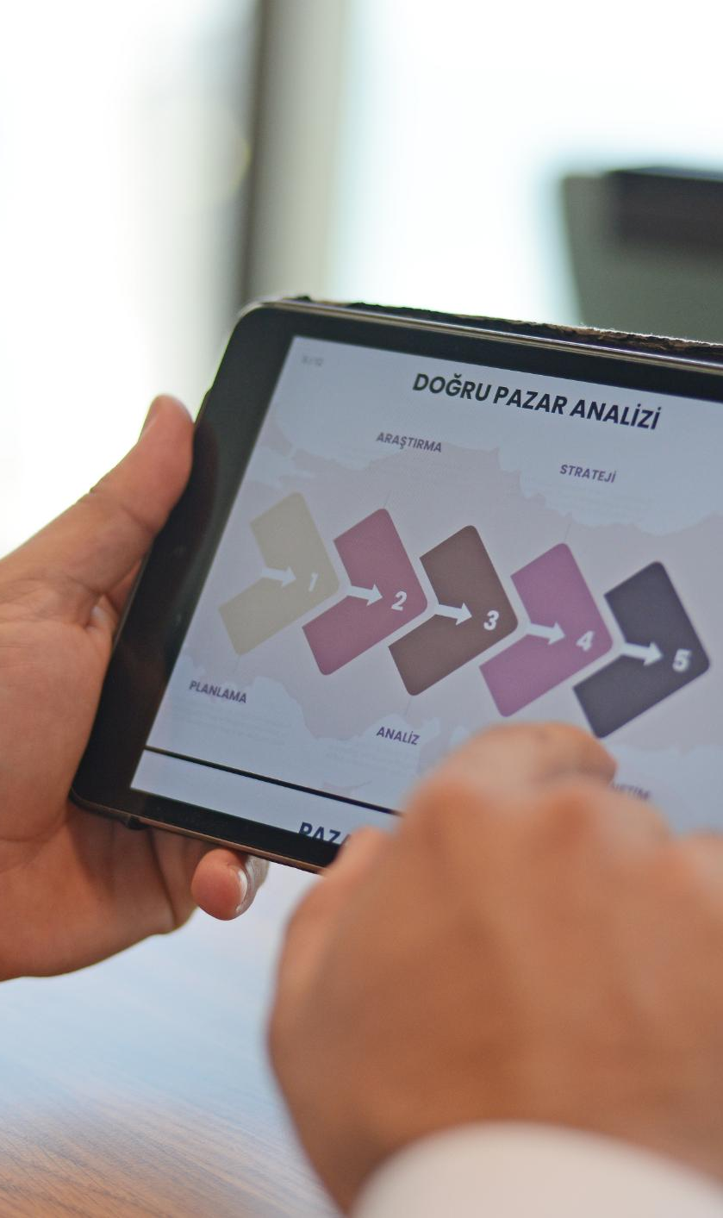
Integration with Dynamics 365
Copilot Studio integrates seamlessly with Dynamics 365 Customer Service, providing users with the ability to manage copilots directly from the Dynamics 365 interface.
Notes:
Copilot Studio seamlessly integrates with Dynamics 365 Customer Service, allowing you to manage copilots directly from the Dynamics 365 interface.

Slide 9

Customization Options
Custom Fields
Copilot Studio allows you to customize fields to your specific needs, which can help you capture information unique to your organization or industry.
Conditional Responses
Copilot Studio also provides conditional responses, which allow you to automatically respond to specific user inputs or conditions, making the copilot more efficient and effective.
Notes:
Copilot Studio offers a range of customization options, such as custom fields and conditional responses, that allow you to tailor copilots to your specific needs.

Slide 10

Seamless Integration Techniques
To ensure a seamless handoff, it is important to define clear criteria for when a customer inquiry should be handed off from the copilot to a customer service representative. Techniques such as clear communication, standardized procedures, and training can help achieve a seamless handoff.
Notes:
To ensure a seamless handoff, it is important to define clear criteria for when a customer inquiry should be handed off from the copilot to a customer service representative. We will provide techniques for achieving a seamless handoff.

Slide 11

Real-World Applications
Improved Customer Service
Copilot Studio has helped organizations improve their customer service by providing them with tools to enhance customer experience, streamline communication, and resolve issues more effectively.
Streamlined Communication
Copilot Studio streamlines communication between customers and customer service representatives. It provides a single platform for all customer service interactions and allows representatives to handle multiple conversations simultaneously.
Issue Resolution
Copilot Studio provides tools to help customer service representatives resolve issues more effectively. It provides access to customer history, real-time data, and analytics, enabling representatives to make informed decisions and provide better service.
Notes:
We will showcase real-world applications of Copilot Studio and how it has helped organizations improve their customer service.

Slide 12
Best Practices for Handoff
The best practices for handoff include training customer service representatives on copilot responses, monitoring copilot performance, and continuously refining copilot responses.
Notes:
The best practices for handoff include training customer service representatives on copilot responses, monitoring copilot performance, and continuously refining copilot responses.

Slide 13

Key Takeaways
Copilot Studio Features
Copilot Studio offers several key features, such as seamless integration with Dynamics 365, customization options, and real-world applications.
Best Practices for Handoff
Best practices for handoff include training customer service representatives, monitoring copilot performance, and continuously refining copilot responses.
Notes:
Copilot Studio is a powerful tool that allows you to build custom copilots for Dynamics 365 Customer Service. Copilot Studio offers several key features, such as seamless integration with Dynamics 365, customization options, and real-world applications. The best practices for handoff include training customer service representatives, monitoring copilot performance, and continuously refining copilot responses.

Slide 14

Thank You and Contact Information
Notes:
Thank you for attending our presentation on Building Custom Copilots for Dynamics 365 Customer Service. If you have any further questions or would like to learn more about Copilot Studio, please reach out to us at [contact information].

